Slide 1
Experimental comparison of kinematics and control interfaces for laparoscope positioners
Benoît Herman^{1,2}, Alba Olías López^{1,3}, Catherine Rasse⁴, Benoît Raucent¹
¹ Université catholique de Louvain, Center for Research in Mechatronics
² Fonds de la Recherche Scientifique – FNRS
³ Universidad Politécnica de Madrid, Escuela Técnica Superior de Ingenieros Industriales
⁴ Université catholique de Louvain, Institute for Multidisciplinary Research in
Quantitative Modelling and Analysis
NCTAM2012 – RMA, Brussels − 10.05.2012

Slide 2
Imagine…
You drive a car
  On a sinuous road
  Backwards
  Looking only in a side mirror
  With you passenger moving the mirror now and then
  With one hand only on the steering wheel
  With a non constant steering ratio
  The other hand holding a cup full of boiling hot coffee
  And with one eye shut
Guess what?
    You’re performing laparoscopic surgery!
2

Slide 3
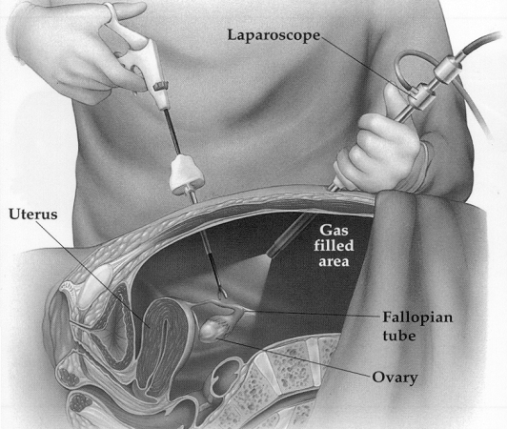
Laparoscopic surgery
Minimally invasive technique
  Abdominal cavity explored with a rigid endoscope
  Proven benefits for patients: e.g. size of scars, traumatism and pain
  More challenging for surgeons: e.g. complex gestures, fatigue, stress
Manual camera handling by assistant
  Lack of coordination, wrong motions
  Image instability, tremors
  “Third hand” required
Passive instrument holders:
not suitable
    Need for robotic
    assistance
3

Slide 4
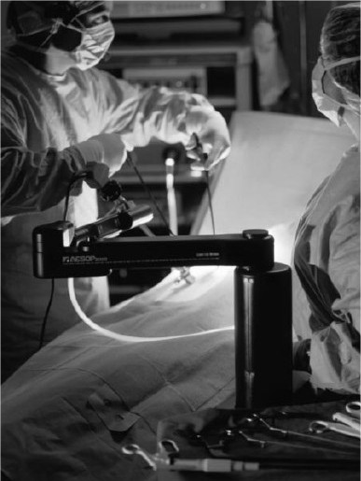
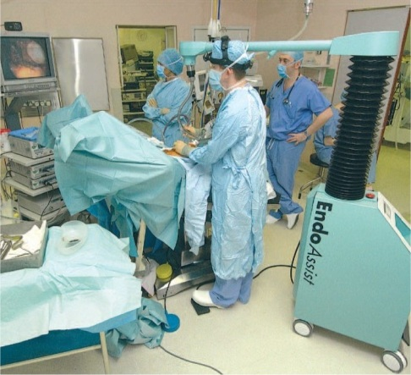
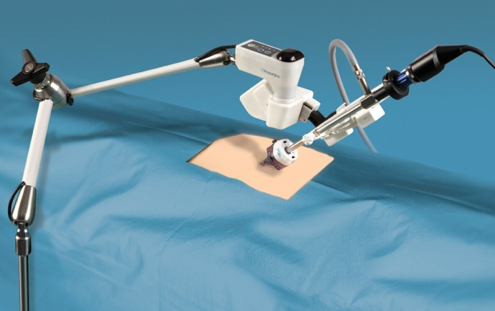
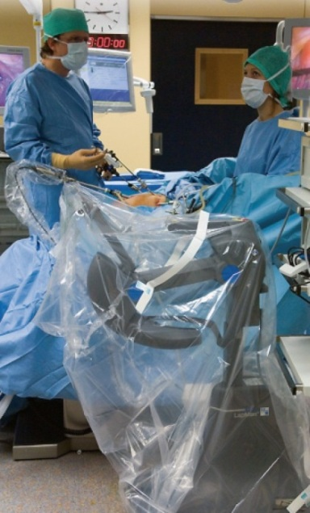
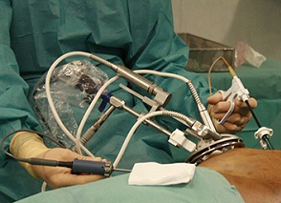
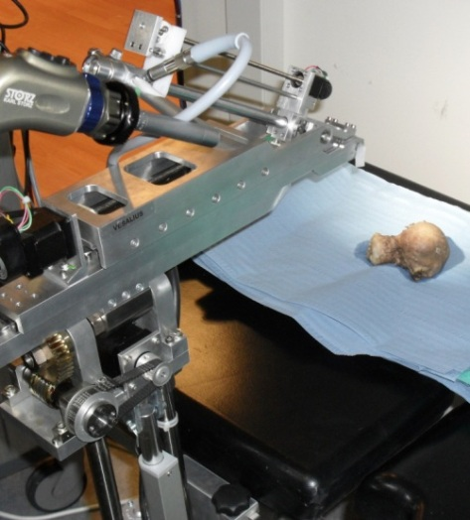
Existing robots
EndoAssist (Armstrong Healthcare)
FreeHand (Prosurgics)
AESOP (Computer Motion)
ViKY (Endocontrol)
LapMan (Medsys)
Vesalius (KULeuven)
4

Slide 5
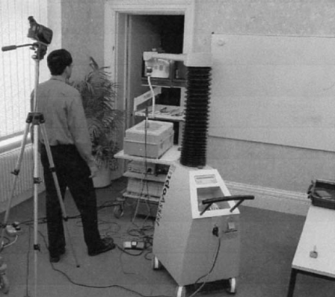
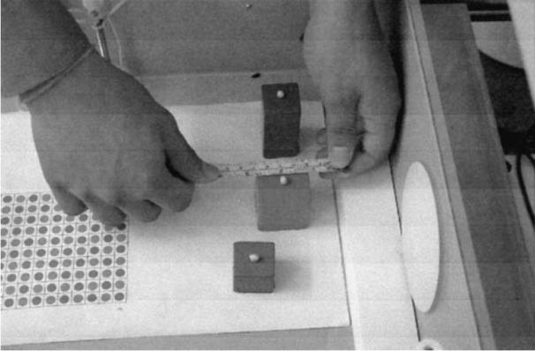
Performance assessment
No standard to measure performances…
Short clinical studies
  Proof of concept: most robots were introduced by this means
    Image stability, less lens-organs contacts, less fatigue, assistant free…
  Metric: operation duration
    Not reproducible
    Includes set up and break down
Ex vivo experiments [Yavuz 2001, Nebot 2003]
  More standardized motions
  Compares whole devices
  (AESOP vs. EndoAssist)
    What is the influence
    of each factor?
5

Slide 6
Goal of this study
To assess the influence of two factors on motion duration (and intuitiveness)
  Kinematics (coordinate frame in which laparoscope motions are controlled)
  Number of controllable directions
Through a phantom experiment
  Task designed to avoid any bias
Using a single robotic platform to exclude all uncontrollable sources of variability between artifacts
  Maximum laparoscope velocity
  Acceleration and deceleration duration
  Reaction time of the interface
  Etc.
6

Slide 7
Kinematics (1)
A laparoscope has 4 DOF
  Translation along longitudinal axis (zoom in and out)
  Self-rotation
  Rotation around two axes passing through the incision (left-right and up-down: pan motions of the image in the monitor)
Natural way to move it
  Intrinsic coordinate system: longitudinal axis + principal image directions
  Motion regulated by visual feedback on the monitor when performed by hand
AESOP does this
  Very intuitive image motions, as expected by the surgeon
  Need for 3 actuated joints for pan motions
  Kinematic coupling between actuators
7

Slide 8
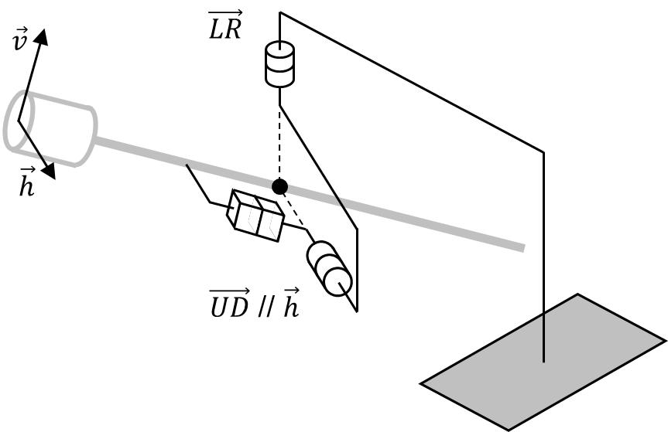
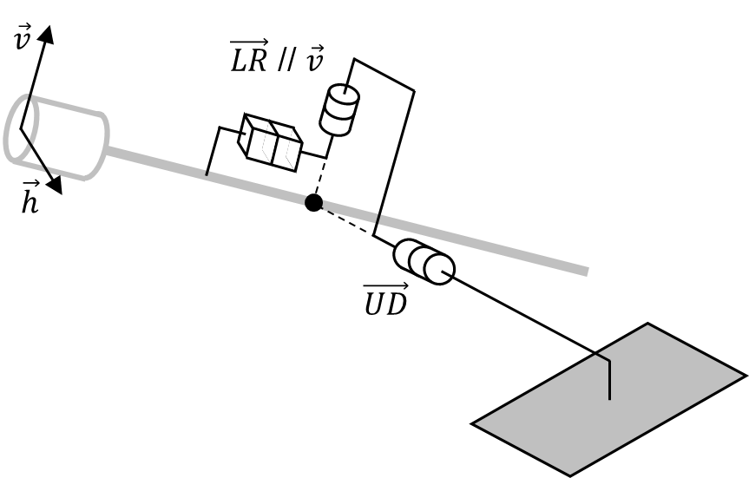
Kinematics (2)
To reduce complexity
  Hybrid coordinate system with one fixed and one mobile axis of revolution
  Decoupling possibility: one motor = one motion
    2 DOF require 2 motors (not 3)
2 main families
ViKY, EndoAssist, FreeHand, da Vinci S and Si
EVOLAP, LapMan, Vesalius*
8

Slide 9
Control interface
“Natural” approach: real-time navigation
  Footpad
  Voice
  Head/eye motion
  Joystick on instrument
“Robotics” approach: target indication
  Instrument tracking (external or in image)
  Line of sight tracking
  Vocal control of a “cursor” on monitor
Characteristics
  Reaction time, order recognition rate, intuitiveness, comfort, …
    Depend mostly on implementation
  Number of controllable directions: usually Cartesian directions only!
    Additional diagonals, or omnidirectionality
9

Slide 10
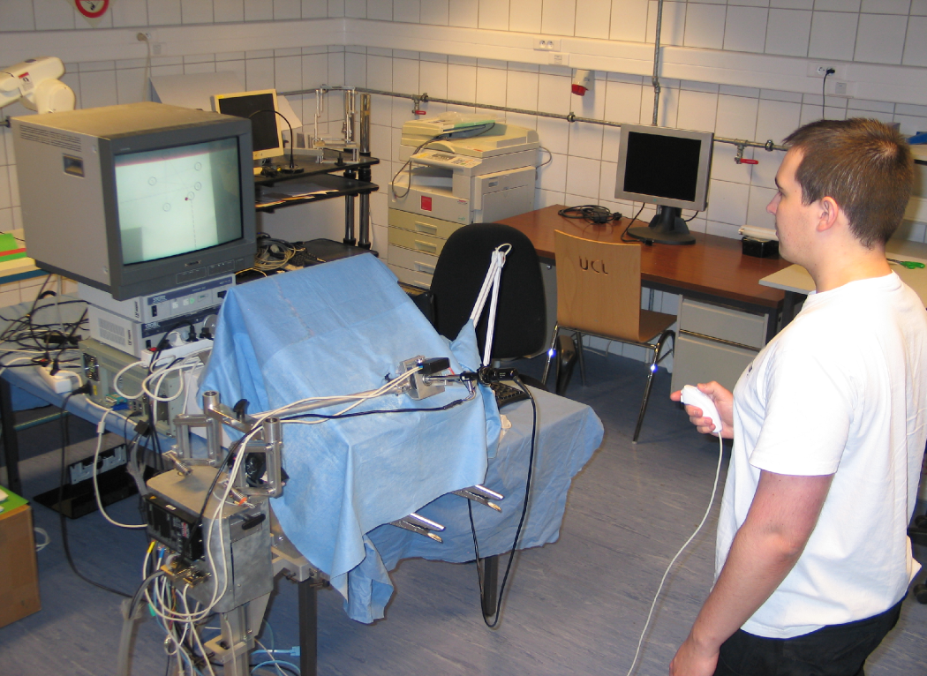
Methodology – Setup overview
monitor with red dot at center
pelvitrainer
laparoscope
+ camera
joystick
computer with dSPACE real-time controller + I/O’s
laparoscope rotation device
EVOLAP robot
10

Slide 11
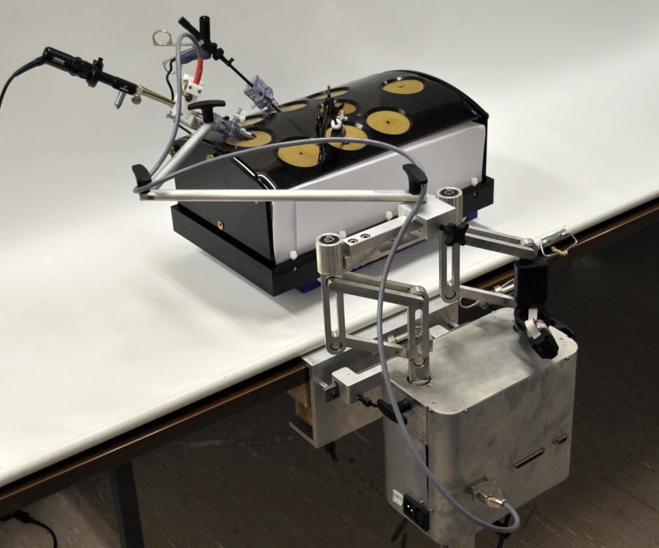
Methodology – EVOLAP overview
Decoupled 3DOF architecture
Instrument-mounted joystick omnidirectional and proportional
Local 1DOF zoom device: translation
Lockable articulated arm with passive RCM
Main 2DOF remote
manipulator: angular motions
11

Slide 12
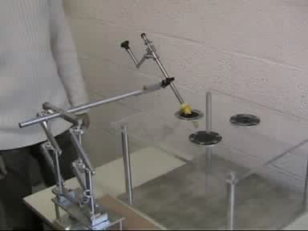
Methodology – EVOLAP overview
Decoupled 3DOF architecture
Circular translations of the grasping point around the incision
No robot and arm motion during zoom
Intra-abdominal workspace ~ half-sphere
➔ Static balancing with spring
➔ Back-drivability
12

Slide 13
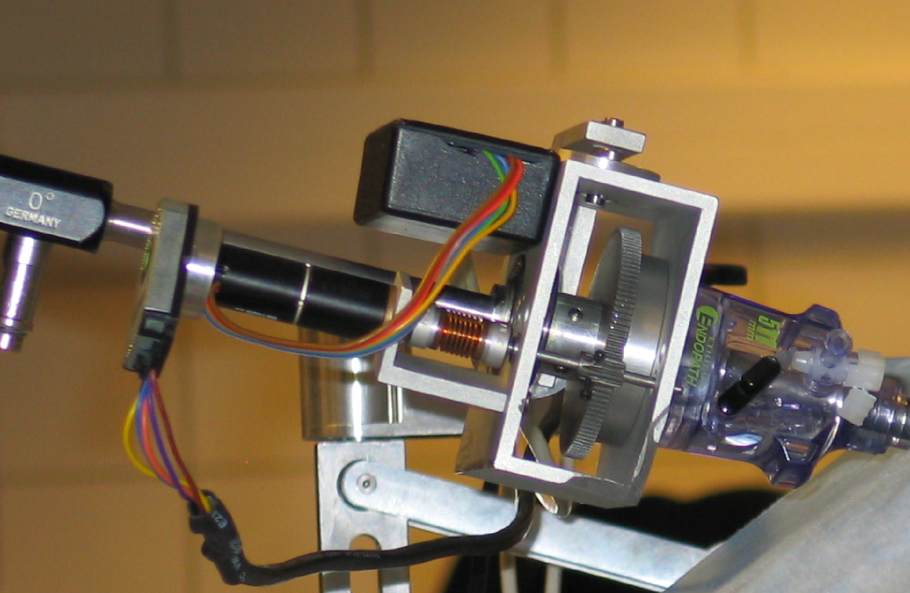
Methodology – EVOLAP upgrade
Need for a third revolute DOF
  To move the laparoscope in all
  3 coordinate frames
  Local self-rotation device replaces
  the unused zoom device
Control diagram update
  2 additional kinematics
  3 sets of directions
Use of Wii Nunchuck
  Good ergonomics
  Shorter learning curve than
  the instrument-mounted
  joystick
brushless DC motor + gearbox + encoder
gears
elastic coupling
trocar
13

Slide 14
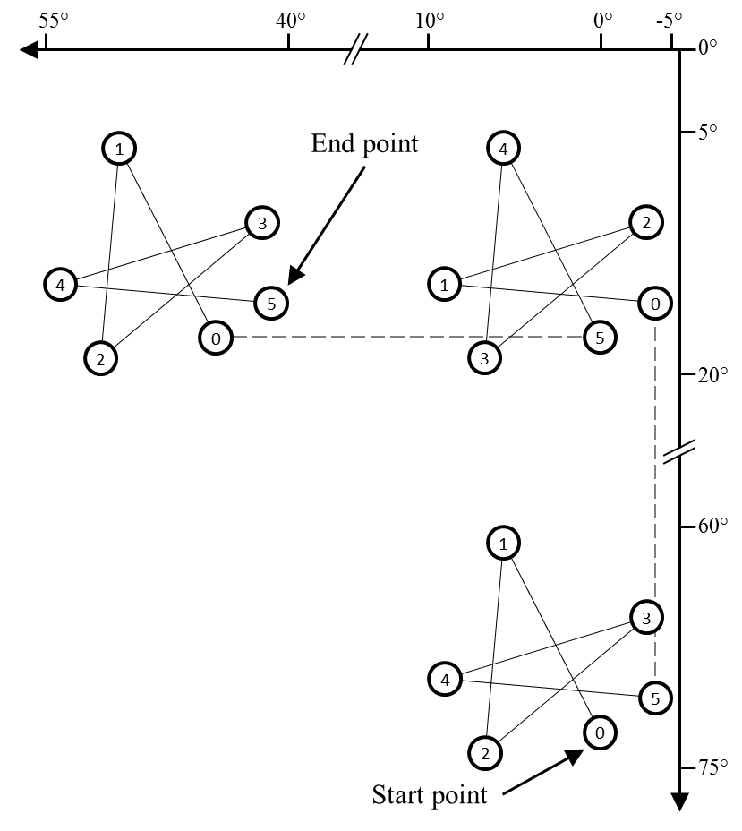
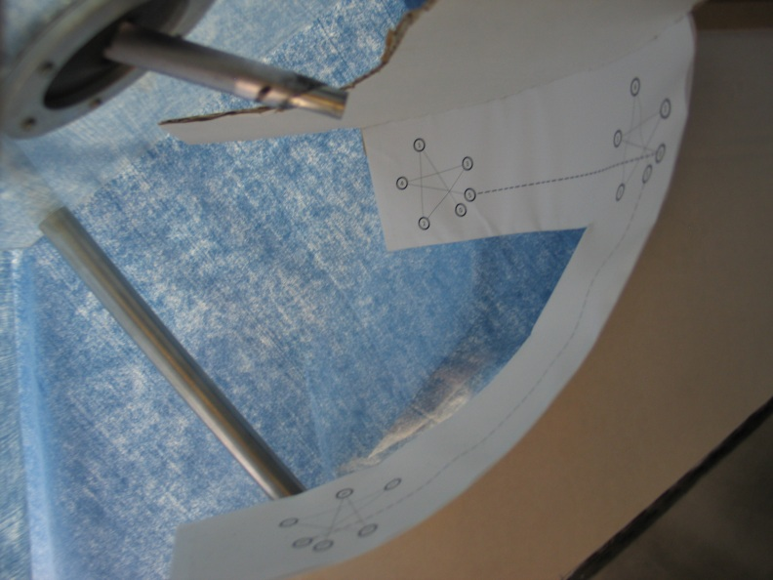
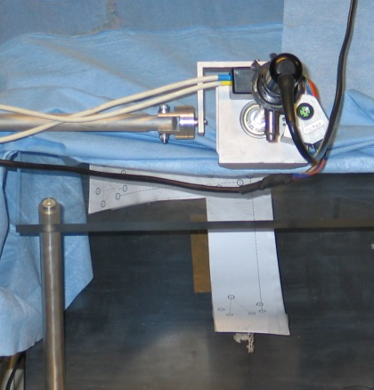
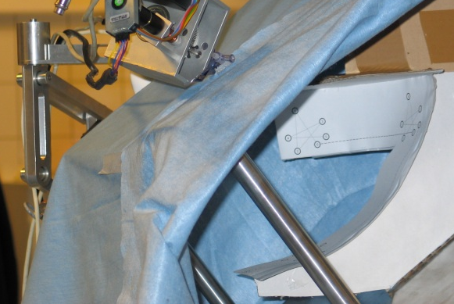
Methodology – Tasks and metrics
Point to point trajectory
Metrics
  Time for task completion
  Automatic stopwatch: starts with motion and stops when task completed
  Other real-time recordings for further investigation
14

Slide 15
Methodology – Protocol
5 subjects
  PhD students in mechatronics
  No previous experience in robotic surgery
  Some are (very) good at video games
Randomization
  Kinematics in random order
  For each kinematics, joystick mode in random order
4 valid repetitions for each factors combination
  If learning effect, repeat until 4 repetitions are stable
15

Slide 16
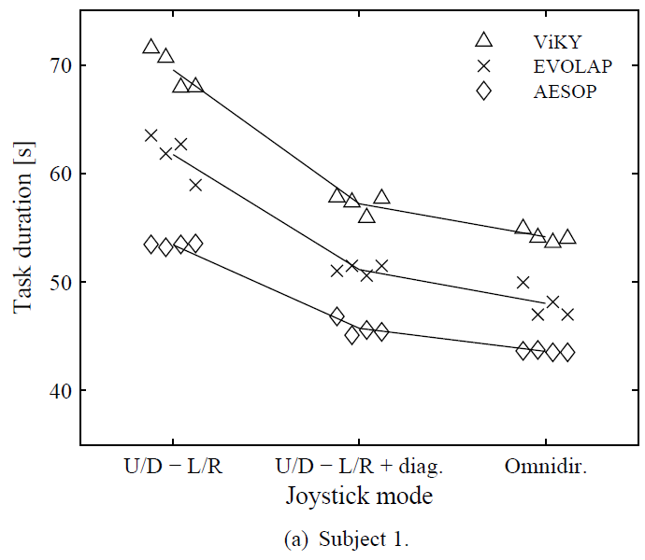
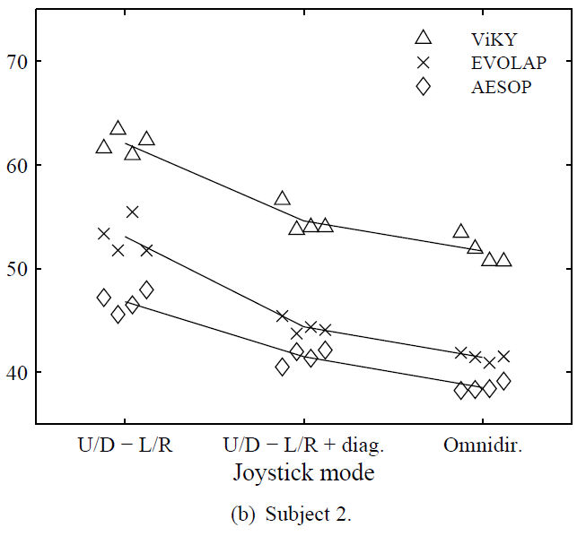
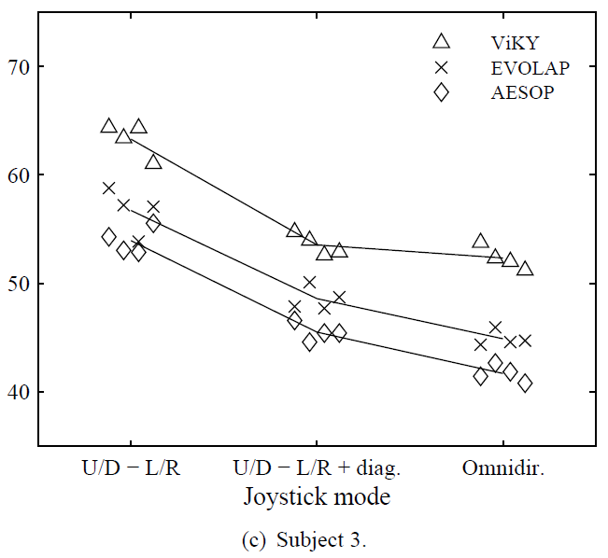
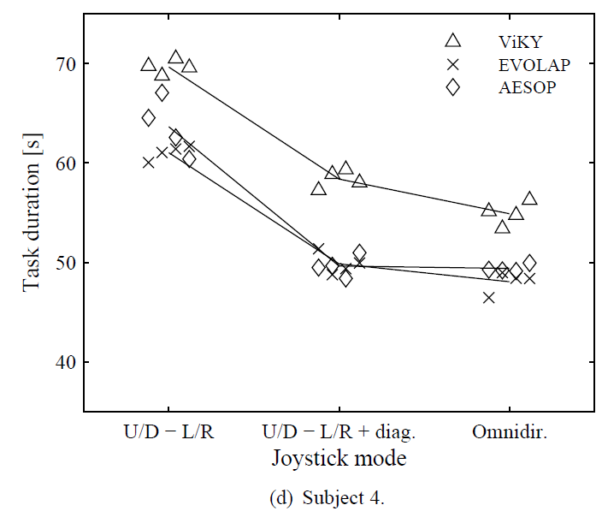
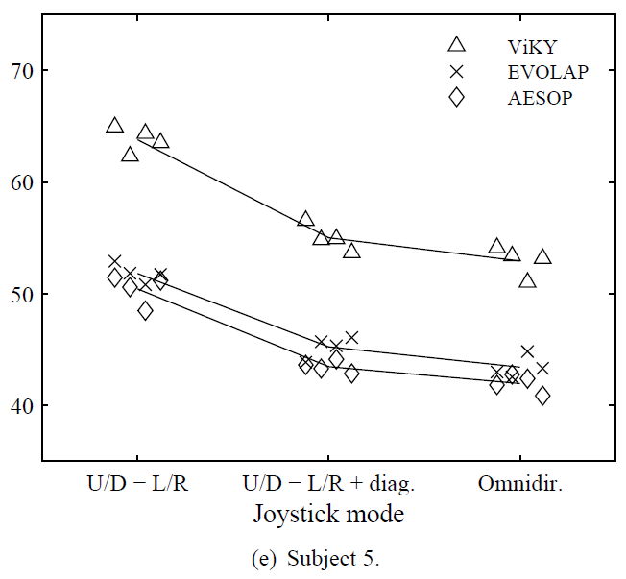
Results – Individual subjects
16

Slide 17
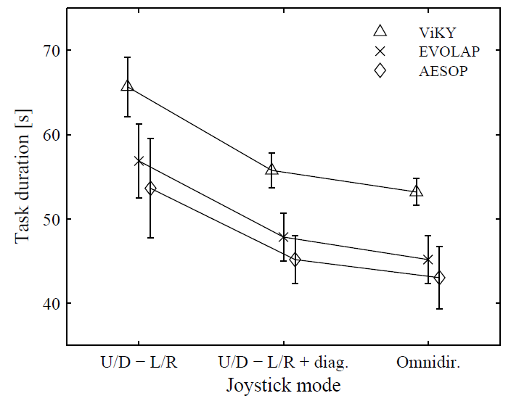
Results – All subjects
2-way ANOVA
  Significant for both factors (p < .0001)
  No interaction between factors (p = 0.43)
Tukey HSD test for multiple comparisons
  ViKY slower than EVOLAP (p < .0005) and AESOP (p < .0001)
  EVOLAP a bit slower than AESOP but not significant (p = 0.1)
  Cartesian mode slower than with
  diagonals (p < .0001)
  Omnidirectional mode faster than
  with diagonals (p = 0.0025)
17

Slide 18
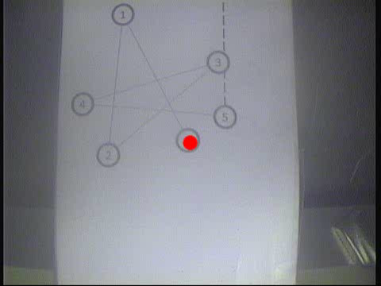
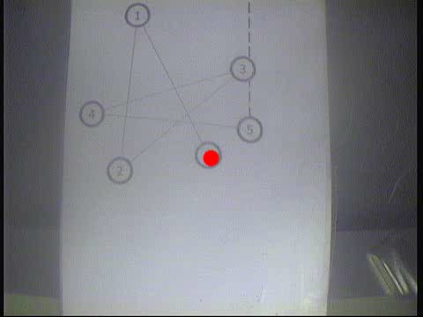
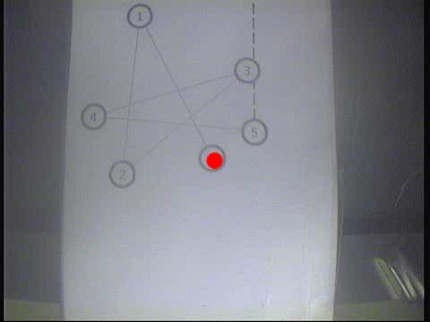
Results – Influence of kinematics
AESOP
EVOLAP
ViKY
18

Slide 19

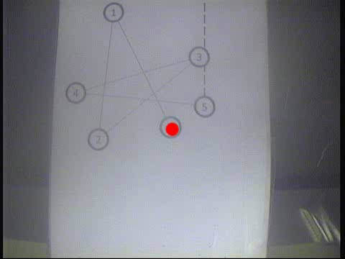
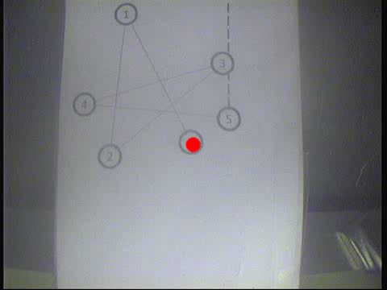
Results – Influence of directions
Cartesian
+ diagonals
Omni
19

Slide 20
Conclusions
New methodology for experimental assessment of motion performance of laparoscope positioners
Kinematics and number of controllable directions have significant influence on motion duration (and intuitiveness)
AESOP kinematics is optimal but EVOLAP offers a good balance between performance and complexity
Cartesian directions are not sufficient
Adding diagonals can be done easily with most modalities and improve performance
20

Slide 21
What’s next?
Results should be confirmed with surgeons (including usability assessment)
Influence of angular speed should be assessed
  Possible plateau: too high speed might reduce accuracy
  Constant angular velocity does not lead to a constant image velocity!
Influence of kinematics on complex surgical tasks
  Self-rotation of the laparoscope changes the image orientation with respect to organs and instruments
  Could increase the difficulty to perform challenging gestures
Reach the market…
21

Slide 22
Experimental comparison of kinematics and control interfaces for laparoscope positioners
Benoît Herman^{1,2}, Alba Olías López^{1,3}, Catherine Rasse⁴, Benoît Raucent¹
¹ Université catholique de Louvain, Center for Research in Mechatronics
² Fonds de la Recherche Scientifique – FNRS
³ Universidad Politécnica de Madrid, Escuela Técnica Superior de Ingenieros Industriales
⁴ Université catholique de Louvain, Institute for Multidisciplinary Research in
Quantitative Modelling and Analysis
NCTAM2012 – RMA, Brussels − 10.05.2012

